Slide 1
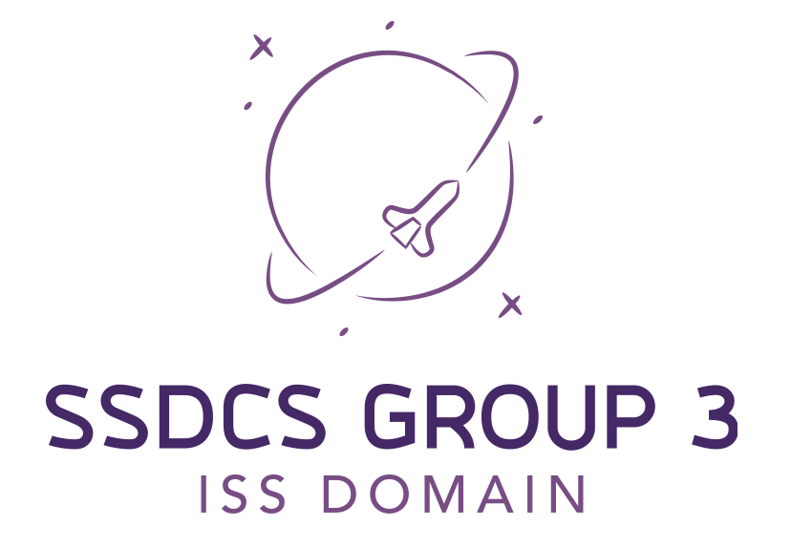


Slide 2
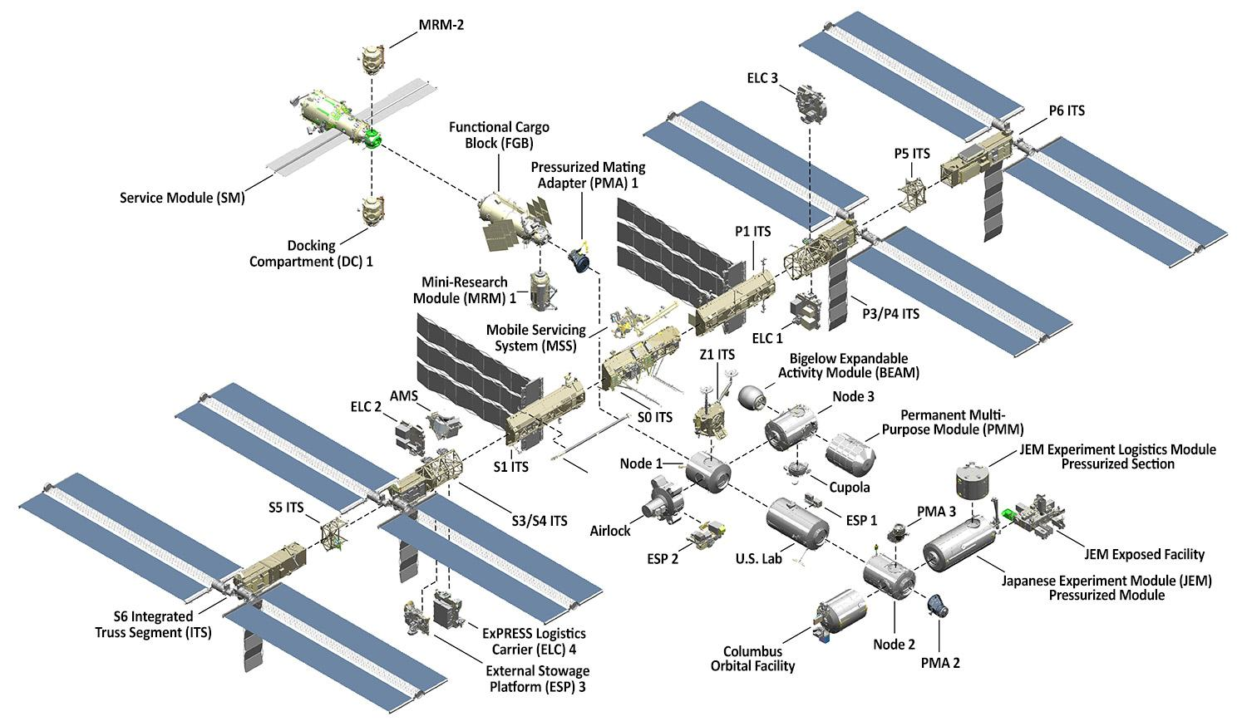
Problem Domain: International Space Station
7 astronauts
2000-2022
5 miles/second
4 hours from Earth

Slide 3
Problem Domain: International Space Station
Life Support Hardware
Oxygen Production
Radiation Shields
Carbon Dioxide Scrubbers
Command and Control Software
High Availability
Extremely Secure
Data Storage
Operated from Defined Locations
Life Support Sensors
Oxygen
Radiation
Carbon Dioxide
Ground Control Dashboard
Monitor Sensors
Toggle Sensors on/off
Control Environment

Slide 4
Requirements
Solution should be fault tolerant
Use microservices & containers to allow for horizontal scaling
Scale to meet changes in the demand profile
Monitor and Control Environment remotely
Data stored in a PostgreSQL DBMS
Data at rest will be secured using AES Encryption
Data in Transit will be encrypted By TLS 1.2+ SSL Certificates
Historic Data will be stored for trend analysis
Data and Command & Control channels exposed via secure REST web services
Strong authentication
Record all logon actions.

Slide 5
Security: OWASP 10 proactive controls
Control C1: Define Security Requirements
C2: Leverage Security Frameworks & Libraries
C3: Secure Database Access
C4: Encode and Escape Data
C5: Validate All Inputs
C6: Implement Digital Identity
C7: Enforce Access Controls
C8: Protect Data Everywhere
C9: Security Logging and Monitoring
C10: Handle All Errors and Exceptions
Achieved By design document
Fernet, PyJWT, Werkzeug, Flask Limiter…
APIs, JWT
data is encoded at rest, in transit
helper methods
authentication, also in comms
user groups ESA, NASA, SpaceX
data encoded, tls
all API access is monitored and logged
all know exceptions are handled

Slide 6
Demo Schedule
Frontend
GC Dashboard
Testing Strategy
Backend
Infrastructure Overview
Logging/Security
Development Pipeline
Static Code Analysis Artefacts

